Slide 1



How to make toast
With delicious CURST?

Slide 2
Four Steps of Algorithmic Audit
4
Long-term Effects
Data Integrity
1
The feedback loops that are engendering
What is that bias looking like and how do we account for it
Algorithmic
Audit
What is the cost of that failure
Do we use substitute variable
3
Accuracy
Definition of Success
2

Slide 3


Right time to ask Right Question?
你爱我吗？
这句话，
不能说得太早，也不能说得太迟。
说得太早，会影响全局，
说得太迟，已经没用了。
热恋的时候问对方：“你爱我吗？”
他便知道你已经爱定他，从此以后，你们的关系就是你爱他多一些。
他不爱你了，你含泪问他：“你爱我吗？”
是不是已经问得太迟？有些事情，太迟才去问，只会显得有点笨。
---张小娴

Slide 4


What-if
Is there any Linear Dependencies?
Will Near Zero Variance Predictors cause model to crash or fit to be unstable?
Can model thrive on correlated predictors?
What’s the assumptions of specific algorithms?
What’s the cost of misclassifications?
How would changes to a datapoint affect my model’s prediction?
Does it perform differently for various groups–for example, historically marginalized people?
How diverse is the dataset I am testing my model on?

Slide 5
What-if
Is there any Linear Dependencies?
Will Near Zero Variance Predictors cause model to crash or fit to be unstable?
Can model thrive on correlated predictors?
What’s the assumptions of specific algorithms?
What’s the cost of misclassifications?
How would changes to a datapoint affect my model’s prediction?
Does it perform differently for various groups–for example, historically marginalized people?
How diverse is the dataset I am testing my model on?

Slide 7

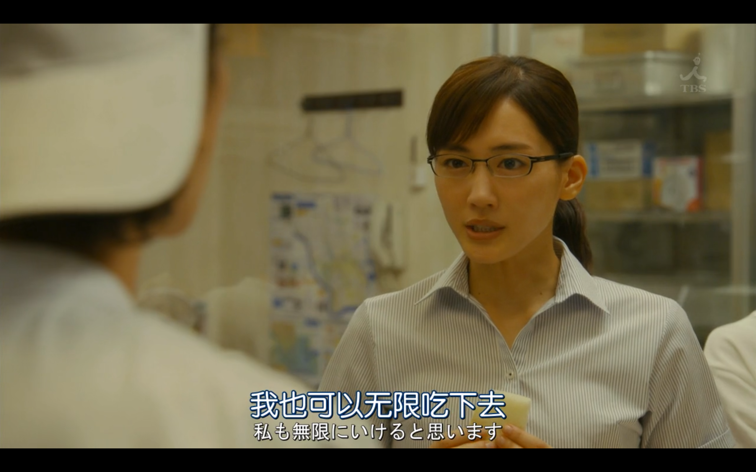

Bon Appetit!
お疲れさまでした
Special Acknowledgement & References
Applied Predictive Modeling by Kuhn and Johnson (2013)
義母と娘のブルース /Gibo to Musume no Blues by TBS
Yeh I (1998). “Modeling of Strength of High-Performance Concrete Using Artificial Neural Networks.” Cement and Concrete research, 28(12),1797–1808
randallzoeng@qq.com

